Slide 1

MAMC01801 Capabilities for Managers
Week 3

Slide 2
Agenda
General Manager’s job description exercise.
Homework: Go shopping!

Slide 3
Today’s thought to begin
I only have three things to do. I have to choose the right people, allocate the right number of dollars, and transmit ideas from one division to another with the speed of light. So, I'm really in the business of being the gatekeeper and the transmitter of ideas."
(Jack Welch)

Slide 4
Review: Setting Up Your Own Company
What referenced information have you used? If not, why not?
Is there any information from other groups you would incorporate in your own company set up? If so, what is it?
What information from other groups you would NOT incorporate in your own company set up?

Slide 5
Homework: Go shopping!
In Week 6 we will be looking at culture in business and how management creates it. Before then we are going to ask that every time you go shopping, you keep an eye out on the following features in the places where you go. Make notes and be prepared to share them with the class.
When you combine all of those impressions into a single overview judgment, what does it tell you about the culture of the shop? Do you think the management created the culture or allowed it to happen? Can you think of a place where management has definitely created a work culture? How can you tell? Share your findings in Week 6.

Slide 6
Homework: Go shopping!
How would you describe:
The physical appearance of the shop?
The way that merchandise is displayed?
The music that the shop is choosing to play ?
The comfort levels in terms of temperature?
The appearance of staff working in the shop?
The reaction of those staff to a new customer entering the shop?

Slide 7
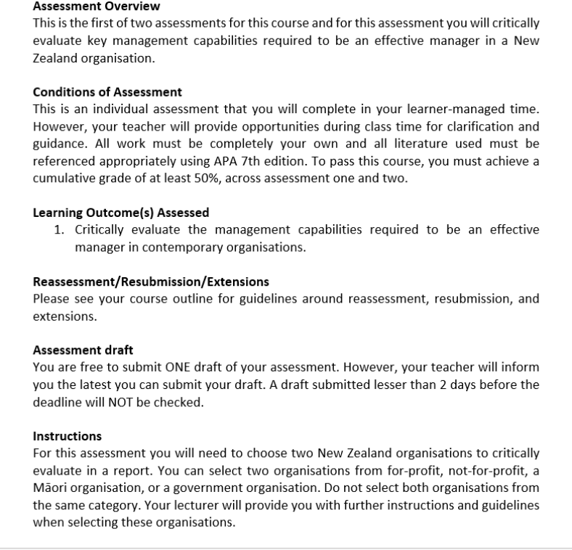
Assessment 1: Report (20% of final grade)
Word count guidance: 2000 words (+/- 10%)
Due date: Friday Week 3 (25 October 2024), 11:59 PM

Slide 8
GROUP Activity: MARK SAMPLE ASSESSMENT 1
In your group mark the sample student assessment based on the Assessment 1 rubric
Share your marking scheme with the class.

